Slide 1

Stock price prediction
UNDER THE GUIDANCE OF DR.CHIRANJITH RAY
B23MCR01

Slide 2
GROUP MEMBERS
DASARI KARTHEEK (S20200010055)
MEESALA SARAN TEJA SUMANTH(S20200010125)
MARAPAKA BANNU DEEPAK(S20200010122)

Slide 3
PROBLEM STATEMENT
Predict the Closing price of a particular stock
Prediction should be mostly accurate with respect to the time
Predicting the Closing price of a particular stock based on the attributes like opening price, highest price, lowest price of the Past
Building a neural network model to predict Price of a particular Stock

Slide 4
PROPOSED APPROACH
The CNN Layer is used to extract local features from the stock price time series.
And then the extracted features are then passed to the BiLSTM layer with SLSTM cells.
The Attention Mechanism can help the model to focus on important parts of the input sequence and learn the correlations between different time steps
So the Attention Mechanism is then applied to the output of the BiLSTM layer with SLSTM cells which produces a weighted representation of the input sequence based on the importance of each time step.
So we can combine these models so that we can use the time sequence of stock price data to obtain more reliable forecasting
Basically we are going to build a model based on the short term dependencies Such as investor sentiment, news events and changes in trading volume and long term dependencies such as moving averages etc.
CNN is suitable to capture the short term dependencies and fluctuations
BILSTM with Attention Mechanism are popular because of the ability to handle sequential data and capture Long term dependencies
We are going to build a Hybrid model for the stock price prediction

Slide 5
PROPOSED APPROACH (MODEL)
CNN BILSTM-AM
CNN
BILSTM WITH AM
To handle the short term Dependencies
To handle the Long term Dependencies

Slide 6
RECAP
Data pre-processing
Implemented a model using CNN-BILSTM

Slide 7
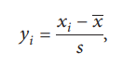
RECAP
First Need to Pre-process the data and then pass it into the Model
Use Date as Index
Replace the Null values with the mean of the column
Normalize the data (Z-Score Normalization)
Need to Reshape the data to pass into the model
Split the data as Training, Validation, and Test
Input Shape for the data that need to be passed into the model must be in the form (Batch Size, Sequence Length, No of Features)
Sequence Length =7 (7 Days )
No of Features =6 (Open, High, Low, Close, Volume, Adj close)

Slide 8
RECAP
Creating Sequential Data with the input data and the Sequence Length
Dimensions of the Sequential Data (Sequence Length, Number of Features) =>(7,6)
Batch of Data is loaded Using the ‘Data Loader’ Object, Now Each Batch will have a Shape of (Batch Size, Sequence Length, Number of Features)
Now Each Batch is passed through the Model

Slide 9
RECAP
Conv1d with Batch size 64, input features(input channels) 6, filters 32, Kernel size 1
(64,6,7) Input Shape to the Conv1d
Activation Function Sigmoid for CNN Layer (64,32,7)
MaxPool Layer with Kernel Size 1 (64,7,32)
BILSTM Layer with Input Size=32, Hidden Size=128,num_layers=2
Activation Function Tanh for BILSTM Layer (64,7,256)
Dense Layer Linear Function with 2*Hidden Size (64,1) -> Output shape
MAE as Loss Function, Adam Optimizer, Learning Rate=0.0001

Slide 10
UPDATES
Used ReduceLROnPlateau scheduler
Used to adjust the learning rate dynamically based on the validation loss
Improves the training of the neural network by dynamically adjusting the learning rate
Applied L2 regularization used to prevent overfitting
Adds a penalty term to the loss function that restricts model from learning overly complex or weight values
Imposes penalty (weight decay) on large weight values, effectively encouraging the model to have smaller weights.

Slide 11
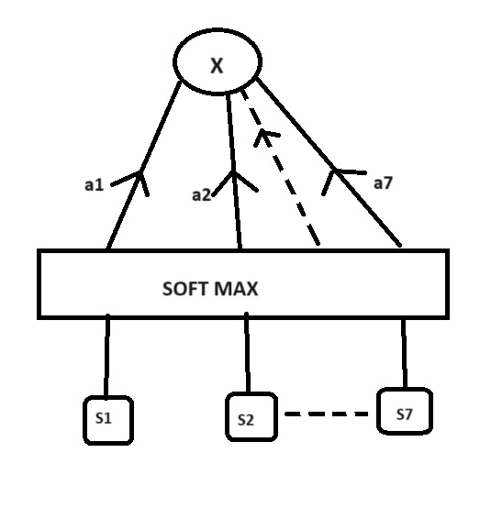
ATTENTION MECHANISM
Attention Mechanism is used to focus on specific parts of the input sequence when making predictions
It helps the model learn the importance of different time steps in the input sequence dynamically
Allows to make predictions while considering which parts of the historical data are most relevant for forecasting stock prices.
Useful when dealing with long input sequences where not all-time steps are equally informative for the prediction task

Slide 12
ATTENTION MECHANISM
Attention Mechanism is applied to the output of the BILSTM layer using a linear layer, followed by a SoftMax activation
Linear layer is used to compute a set of attention weights for each time step in the encoded sequence
These attention weights indicate how much importance should be given to each time step when making predictions.
SoftMax activation ensures that the attention weights sum up to 1 for each input sequence
The weighted sum of the BILSTM output is calculated using the computed attention weights
It is the weighted combination of the hidden states of the BiLSTM (the attention mechanism determines weights)

Slide 13
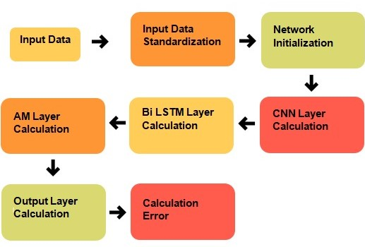
ACTIVITY DIAGRAM

Slide 14
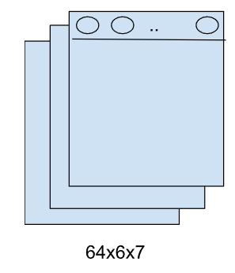

MODEL ARCHITECTURE
POOLING LAYER
CNN LAYER
CONVOLUTIONAL LAYER
Input sequence data
FORWARD LSTM LAYER
LSTM
LSTM
LSTM
LSTM
BILSTM LAYER
…
LSTM
LSTM
LSTM
LSTM
BACKWARD
LSTM LAYER
ATTENTION MECHANISM LAYER
OUTPUT

Slide 15
MODEL ARCHITECTURE SUMMARY
Conv1d with Batch size 64, input features(input channels) 6, filters 32, Kernel size 1
(64,6,7) Input Shape to the Conv1d
Activation Function Sigmoid for CNN Layer (64,32,7)
MaxPool Layer with Kernel Size 1 (64,7,32)
BILSTM Layer with Input Size=32, Hidden Size=128,num_layers=2
Activation Function Tanh for BILSTM Layer (64,7,256)
Attention Mechanism (Linear Layer) (64,7,1)
Weighted sum of attention (64,256)
Dense Layer Linear Function with 2*Hidden Size (64,1) -> Output shape
MAE as Loss Function, Adam Optimizer, Learning Rate=0.0001

Slide 16
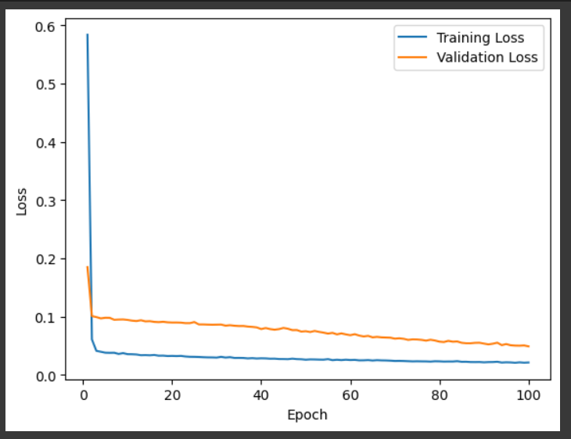
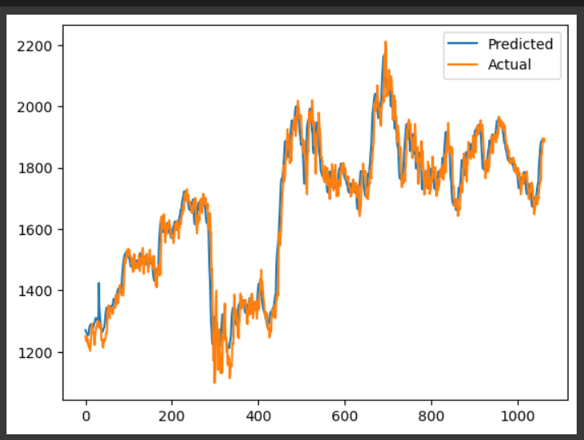
Results
MODEL | MAE | TESTLOSS
CNN BILSTM | 0.0654 | 0.090
CNN BILSTM WITH AM | 0.041 | 0.074

Slide 17
FUTURE WORK
Optimizing the Model for Better Results
Need to work with different Attention Mechanism approaches
Need to explore new different models as a reference

Slide 18
AVAILABLE DATASETS
Yahoo Finance
In this website we can get the previous data of any stock that we want which consists the date open, close, high, low, volume as attributes.
Kaggle
From Kaggle we can get the previous data of the NIFTY 50 stocks and details of other stocks

Slide 19
REFERENCES
Mojtaba, Pooyan, Hamed, Deep Learning for stock market Prediction. Entropy 2020,22
Luca Di, Oleksandr, Artificial Neural Networks architectures for stock price prediction: comparisons and applications. Trace 2016,10, 403-413
Murtaza, Harshal, Shraddha Predicting Stock Prices Using LSTM. IJSR 2017
Sidra, Jayadip Stock Price Prediction Using Convolutional Neural Networks on a Multivariate Time Series. . IEEE 2020
Yahoo Finance Available online www.finance.yahoo.com
Wenjie Lu, Jiazheng Li, Yifan Li, Aijun Sun, A CNN-LSTM-BASED Modelto Forecast Stock Prices.Complexity,vol 2020, Article ID 6622927, 10 pages
Wang H, Wang J, Cao L, Li Y, Sun Q,& Wang, J. (2021). A Stock Closing Price Prediction Model Based on CNN-BiSLSTM. Complexity, vol 2021, Article ID 5360828,12 pages.
Qiu, J., Wang, B., & Zhou, C. (2020). Forecasting stock prices with long-short term memory neural network based on attention mechanism. PLoS ONE, 15(1), e0227222.

Slide 20
THANK YOU

